Slide 1

Azure Arc for SQL Enterprise Dashboard

Slide 2
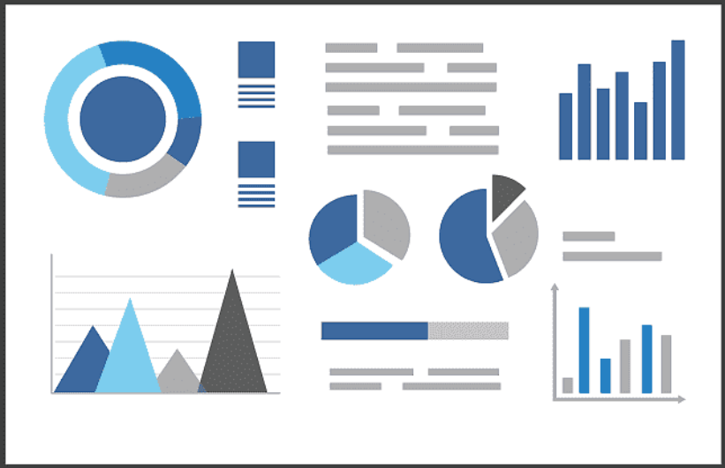
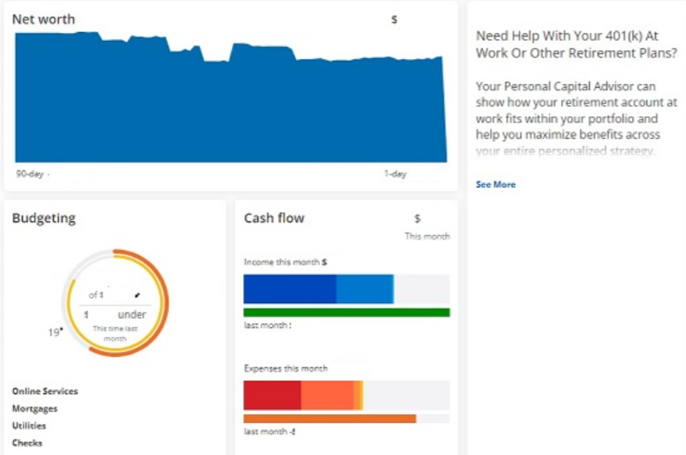

Agenda
Introduction to the ARC Dashboard
Benefits for customers and Microsoft
Delivery and Support
Live Demo

Slide 3


What ARC Dashboard is
GOAL: make ARC more attractive, useful, effective in order to increase the value that ARC provides to customers.
Visuals: It is a Log Analitics Dashboard made of 12+ Charts/visuals exposing detailed and aggregated information about SQL Server infrastructure and ARC Best Practice Assessment results.
Easy: Very easy to install, 10 minutes.
Modular: the customer can choose the charts/visuals more useful for his environment and compose them on a customized Dashboard
One click navigation: with few clicks it is possible to drill down from infrastructure view to issue details on specific databas

Slide 4
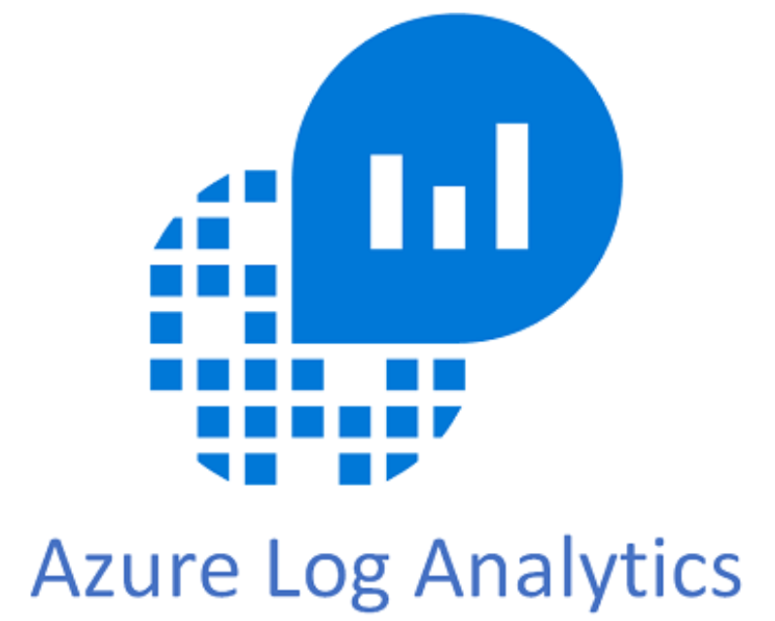
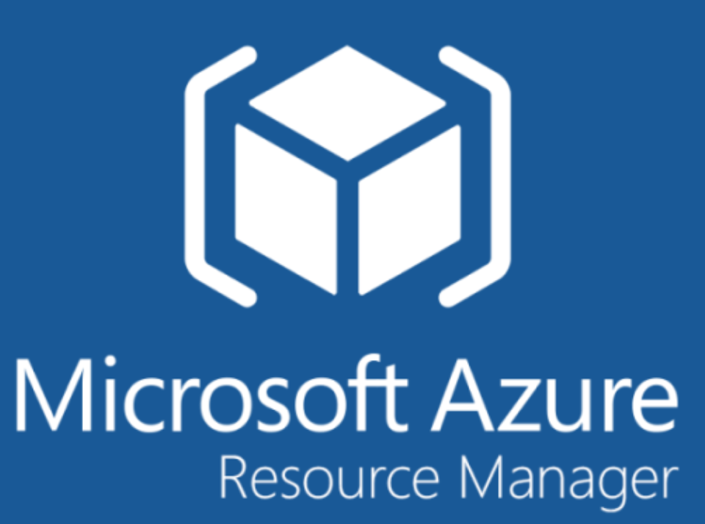

ARC Dashboard: how it works
SQL resources (instances, databases, SQL obsolescence)
ARC agents installation status
Best Practice aggregated data
Kusto Query Language queries
ARC
SQL Best Practice
Assessment

Slide 5

Benefits
SQL Infrastructure perspective
ARC Dashboard provides a comprehensive view of all SQL resources in one single report, on different topics:
Supportability lifecycle
SQL resources
ARC installation
Best Practice Assessment data navigation
ARC Dashboard provides a quick and easy navigation of BPA diagnostic data across SQL infrastructure:
Quick issue identification on entire infrastructure
Easy drill-down from high level to details

Slide 6
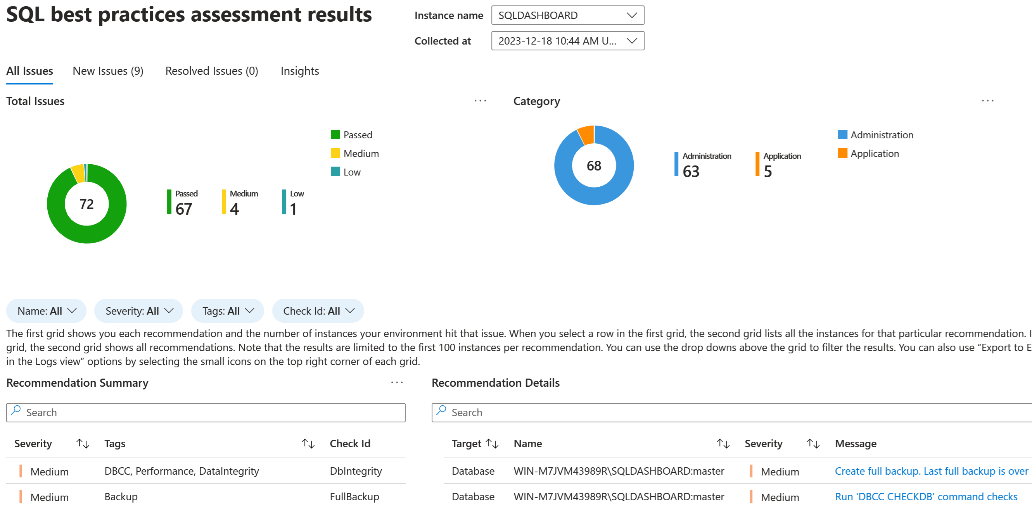
Classic ARC dashboard focused on one instance
By default, ARC portal offers a complete overview of Best Practice Assessment results focused on single instance only.

Slide 7
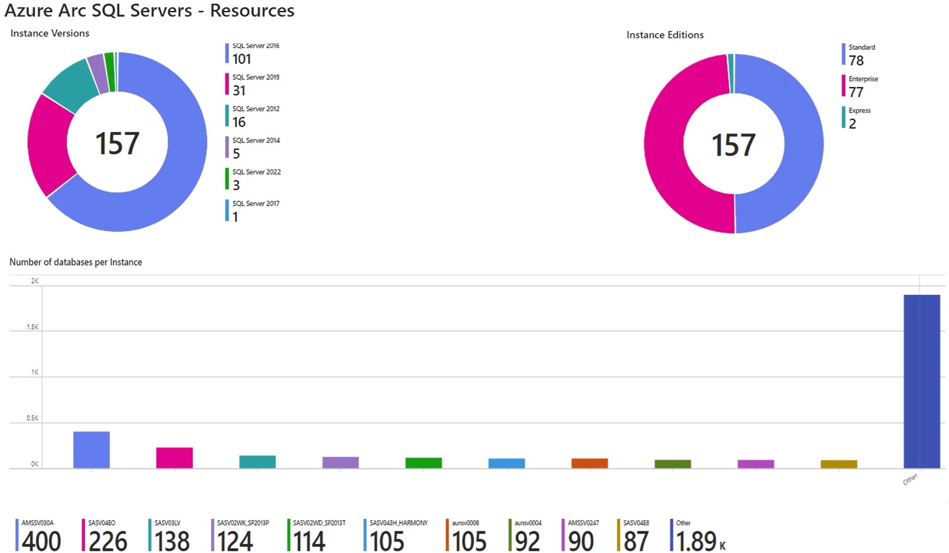
What does my SQL infrastructure consist of?
An initial overview shows the overall SQL infrastructure with the info:
All versions of instances of my infrastructure: 2012, 2016, 2019, etc..
Edition (Standard, Enterprise)
Number of database for each instance

Slide 8
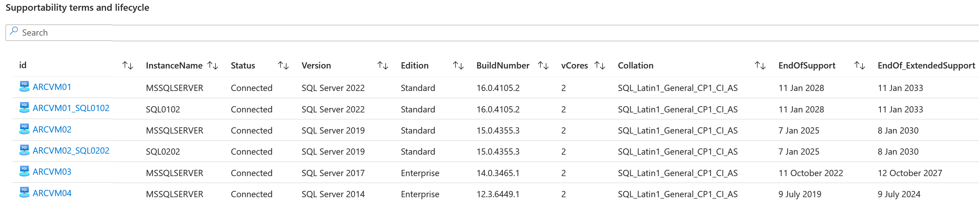
What are the versions and supportability terms of all instances ?
This view shows the complete list of SQL Servers, together with:
Name, version, Edition
Cores
Collation
End of Support (date)
End of Extended Support (date)

Slide 9
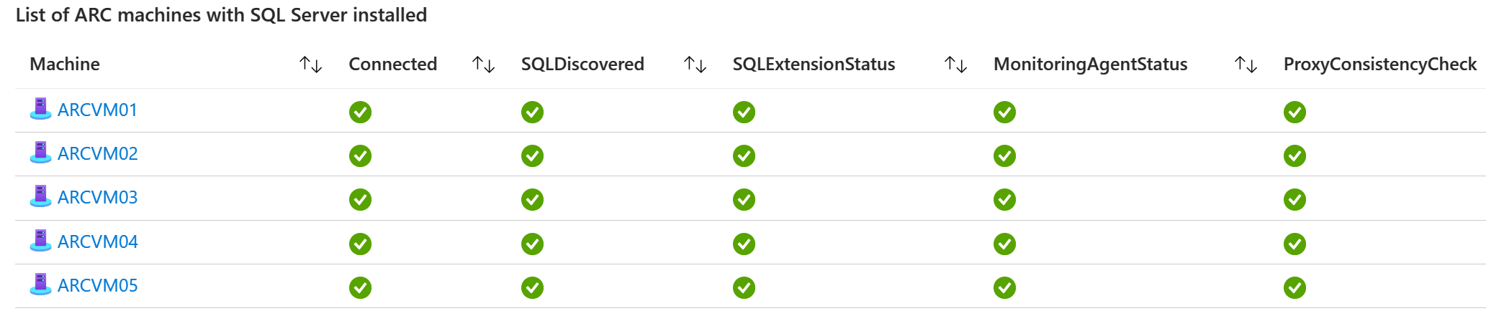
How many SQL instances I have and how many with ARC?
This view shows the complete list of machines with the basic ARC Agent service installed. Starting from this it is possible to discover easily:
Which servers have SQL Server installed
Which servers have been applied with ARC SQL Extension
Which servers are connected

Slide 10
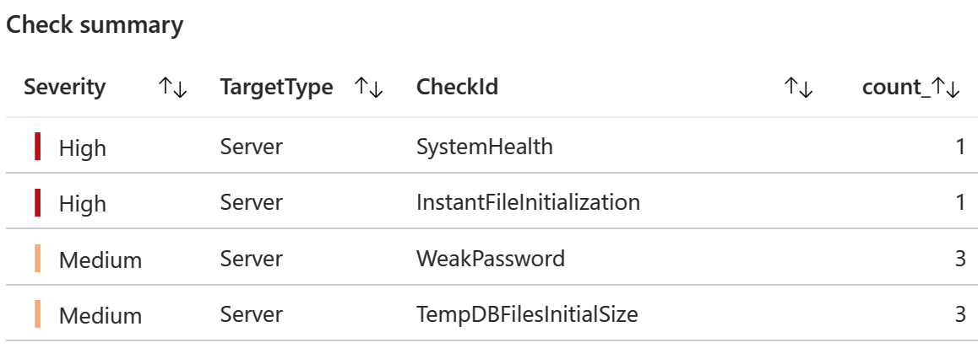
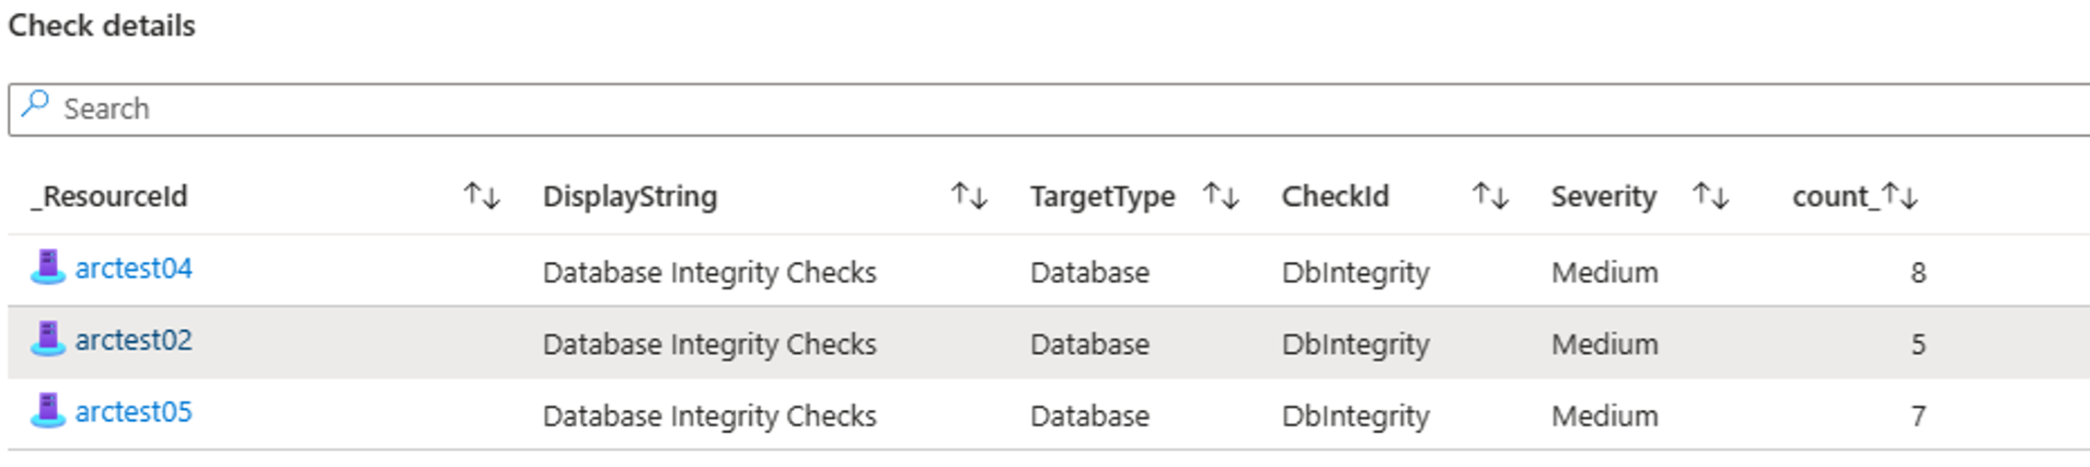
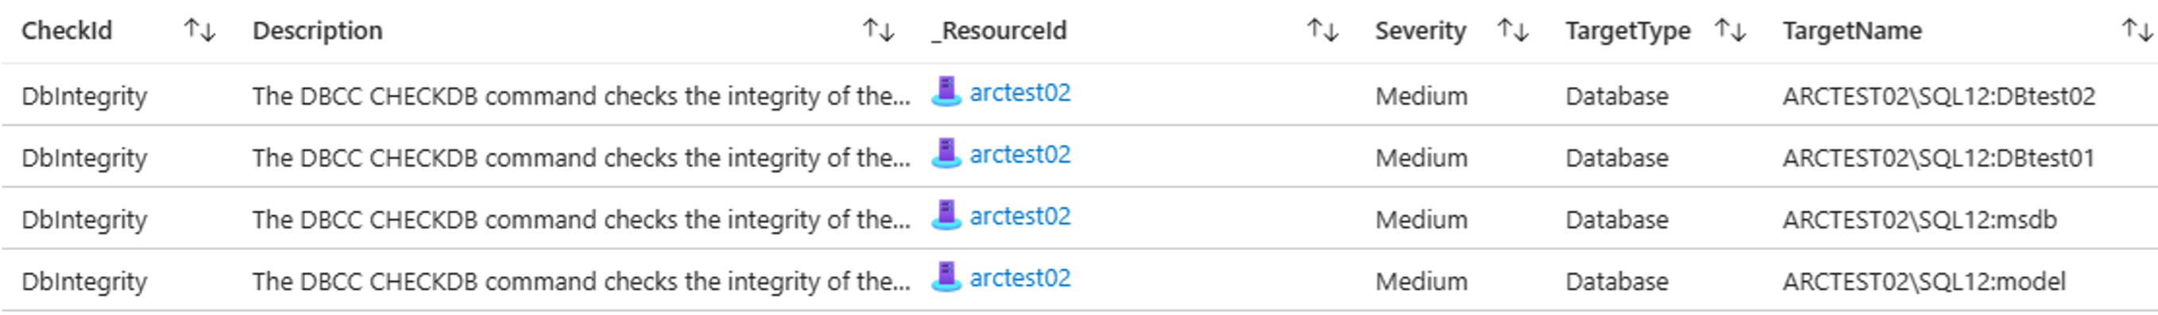
BPA Check details: quick drill down to details
Navigation: From global view to single instance issue in 3 clicks.
From list of issues,
select one issue
Drill down to
affected servers
Drill down to
affected db

Slide 11

Support
The ARC Dashboard is provided under the MIT License:
Copyright (c) Microsoft Corporation.
Permission is hereby granted, free of charge, to any person obtaining a copy
of this software and associated documentation files (the "Software"), to deal
in the Software without restriction, including without limitation the rights
to use, copy, modify, merge, publish, distribute, sublicense, and/or sell
copies of the Software, and to permit persons to whom the Software is
furnished to do so, subject to the following conditions:
The above copyright notice and this permission notice shall be included in all
copies or substantial portions of the Software.
THE SOFTWARE IS PROVIDED "AS IS", WITHOUT WARRANTY OF ANY KIND, EXPRESS OR
IMPLIED, INCLUDING BUT NOT LIMITED TO THE WARRANTIES OF MERCHANTABILITY,
FITNESS FOR A PARTICULAR PURPOSE AND NONINFRINGEMENT. IN NO EVENT SHALL THE
AUTHORS OR COPYRIGHT HOLDERS BE LIABLE FOR ANY CLAIM, DAMAGES OR OTHER
LIABILITY, WHETHER IN AN ACTION OF CONTRACT, TORT OR OTHERWISE, ARISING FROM,
OUT OF OR IN CONNECTION WITH THE SOFTWARE OR THE USE OR OTHER DEALINGS IN THE
SOFTWARE
1. ARC Dashboard is not a “Microsoft product”, but an in-house IP solution provided ‘as-is’. Customers cannot open a ticket or support case as for common products.
2. If the customer reports an issue, Microsoft will take that feedback and incorporate it into a future version of the Dashboard if appropriate, without any SLA, ETA or commitment.
3. By default, Microsoft is not committed in customizing specific customer requests. If customizations are required, a new project/activity will have to be agreed and signed with MS local team.

Slide 12
Demo

